Slide 1
Hostname
hostname
cat /etc/hostname
hostnamectl set-hostname new-hostname
hostnamectl status

Slide 2
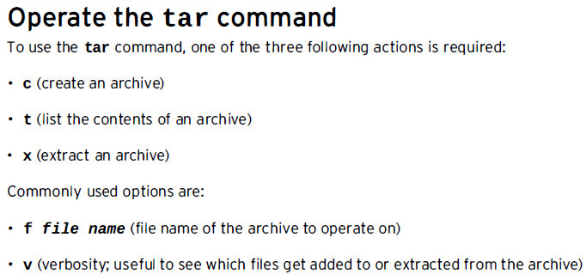
Archiving (tar) and Compressing files (gzip)
Archiving and compressing files are useful when creating backups and transferring data across a network. We can use tar and gzip commands just for that.

Slide 3
tar example
touch f1 f2 f3 f4 f5
tar cf allfiles.tar f1 f2 f3 f4 f5
ls
tar tf allfiles.tar
mkdir tar
mv allfiles.tar tar/
cd tar
tar xf allfiles.tar
ls

Slide 4
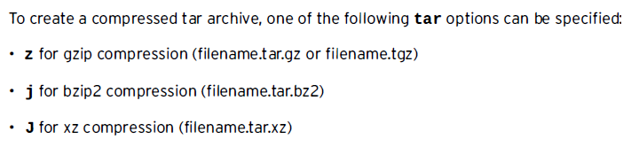
Compressed tar archive
fallocate -l 5M f11
fallocate -l 5M f12
ls -lh
tar czf arc-comp.tar.gz f11 f12
ls -lh

Slide 5
Extract a compressed tar archive
mkdir extract
cd extract
mv ../arc-comp.tar.gz .
tar xzf arc-comp.tar.gz
ls -lh

Slide 6
Copying Files Between Systems Securely
ssh can be used to copy files from one machine to the other using scp command.
Server 1:
ssh-keygen
cat ~/.ssh/id_rsa.pub
Server 2:
vi ~/.ssh/authorized_keys
Server 1:
echo just-for-test > test.txt
scp test.txt ec2-user@server2:/home/ec2-user/

Slide 7
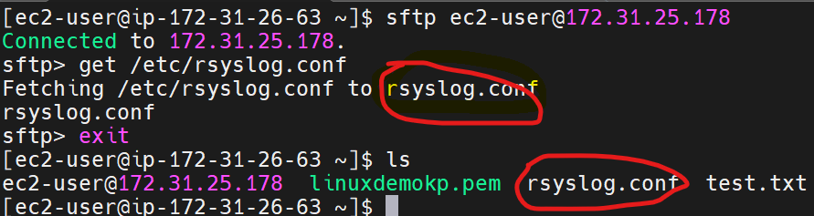
Transfer Files remotely with sftp
If an interactive tool is preferred when uploading or downloading files to a SSH server, the sftp command can be used.
sftp accepts ls, cd, mkdir, rmdir, pwd, put, exit, and get commands.
sftp ec2-user@server2
ls, pwd, mkdir dr, rmdir dr

Slide 8
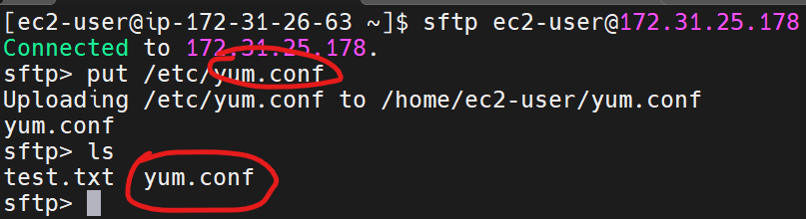
Transfer Files remotely with sftp (contd.)

Slide 9
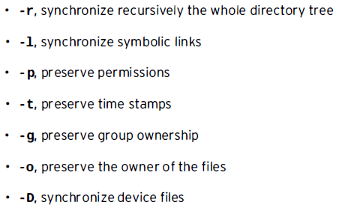
Synchronizing Files Between Systems Securely
The rsync tool is another way to securely copy files from one system to another. It differs from scp in that if two files or directories are similar between two systems, rsync only need to copy the differences between the systems, while scp would copy everything.
rsync -n dry run of changes
rsync -av v=verbosity
a=archive and enables all the following:

Slide 10
rsync example
sudo mkdir /rsync
sudo cp -r /var/log/m* /rsync
ls -l /rsync
sudo rsync -av /var/log/ /rsync
mkdir data
touch data/f1{12..15}
ls -l data
rsync -av data/ 172.31.25.178:/home/ec2-user
on remote server: ls -l

